Slide 1
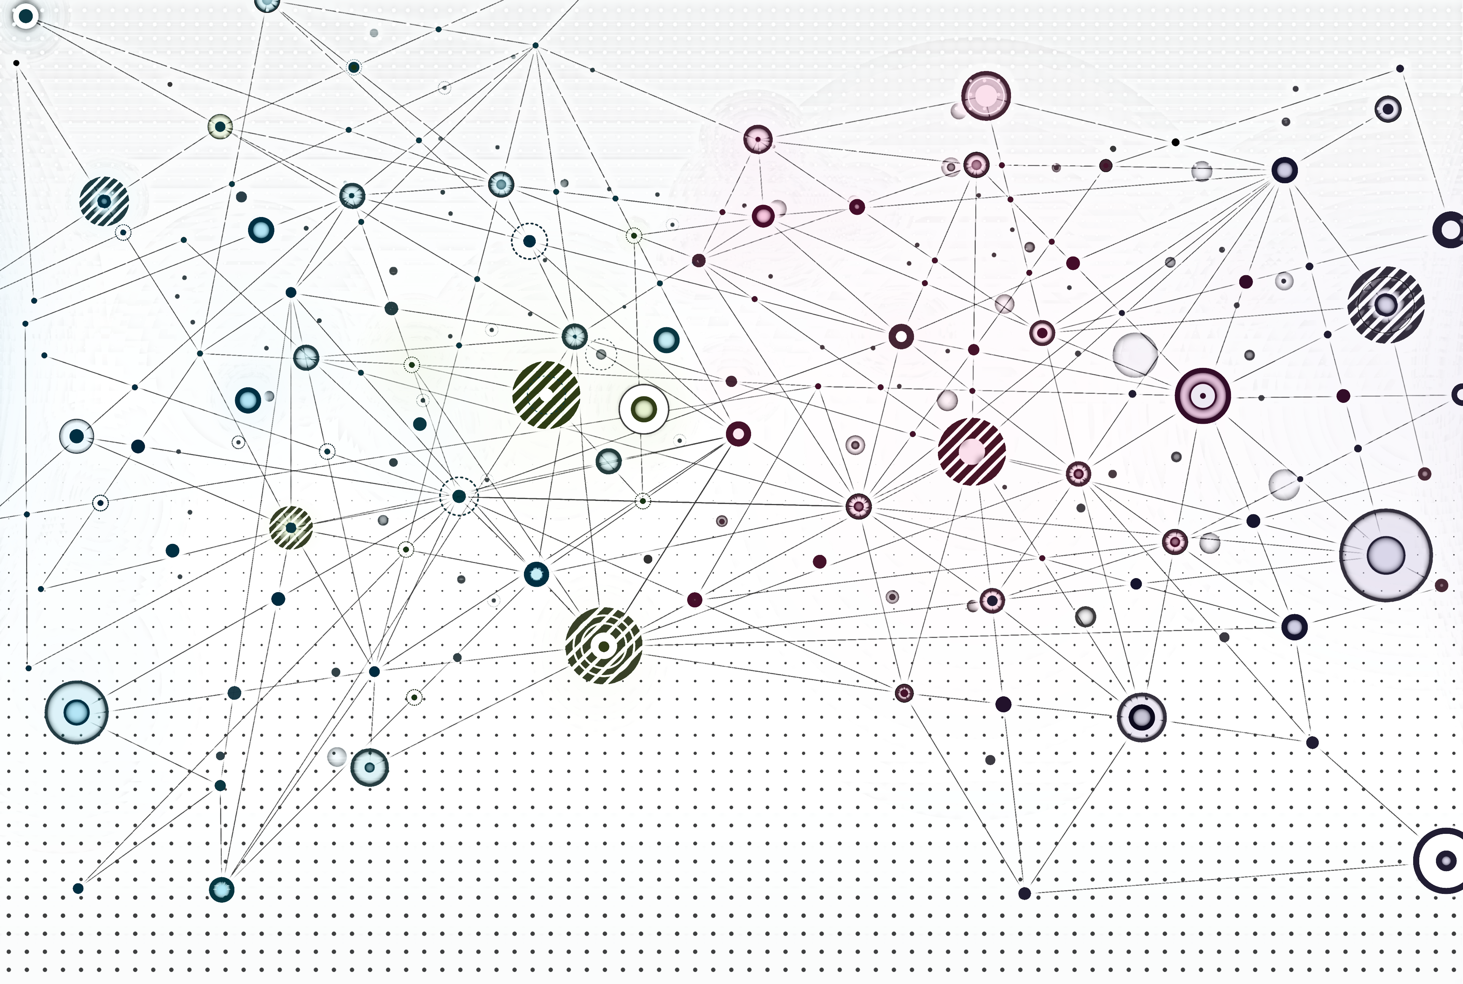
A Generalized Perspective on GNNs

Slide 2
Overview
Recap
Message passing framework
Standard GNNs in the message passing framework
Applicable deep learning tools
Stacking GNN layers
Graph manipulations

Slide 3
Recap

Slide 4
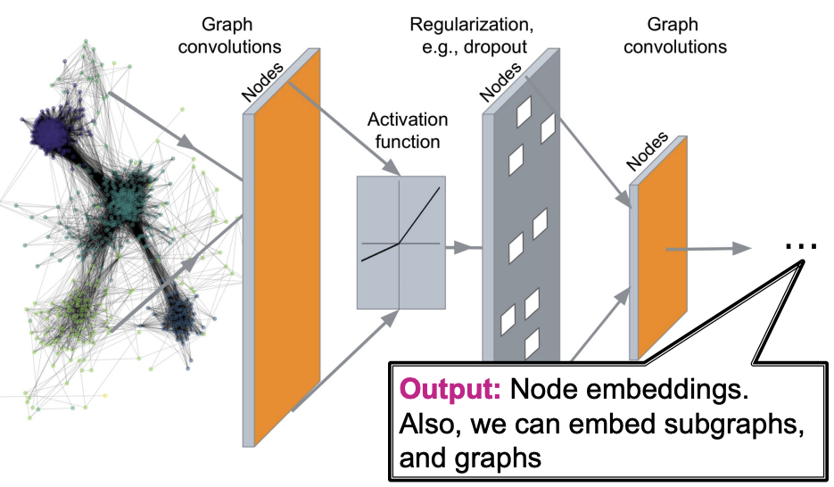
Deep learning on graphs
Image credit: Jure Leskovec, http://cs224w.stanford.edu
Notes:
We would like to develop deep networks that:
learn meaningful features based on both graph structure and node / edge features
are inductive – i.e., new nodes or graphs can be processed by the model
build on existing knowledge from deep learning on other data types

Slide 5
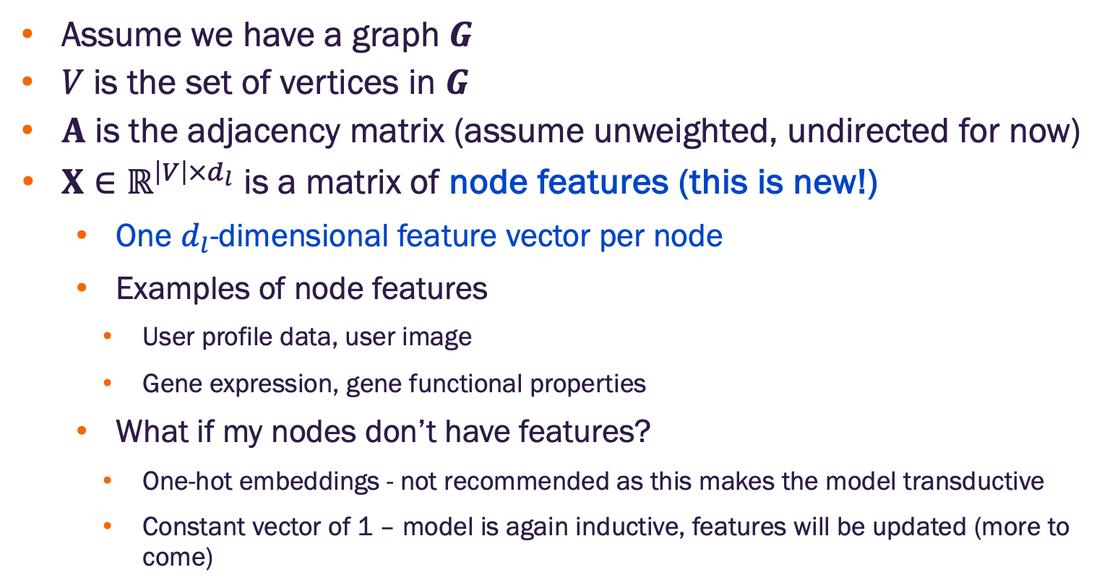
Graph deep learning paradigm
Assume we have a graph $G$
$V$ is the set of vertices in $G$
$A$ is the adjacency matrix (assume unweighted, undirected for now)
$X∈ℝ^{\left|V\right|×d_{l}}$ is a matrix of node features (this is new!)
One $d_{l}$-dimensional feature vector per node
Examples of node features
User profile data, user image
Gene expression, gene functional properties
What if my nodes don’t have features?
One-hot embeddings - not recommended as this makes the model transductive
Constant vector of 1 – model is again inductive, features will be updated (more to come)

Slide 6
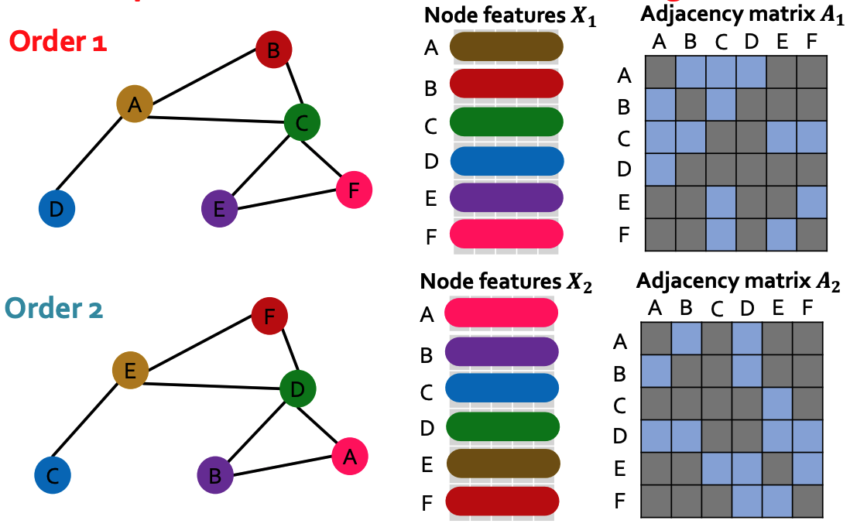
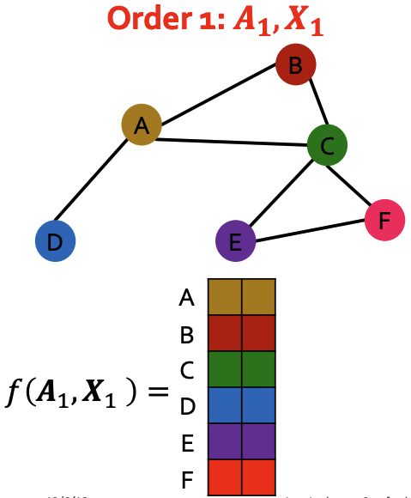
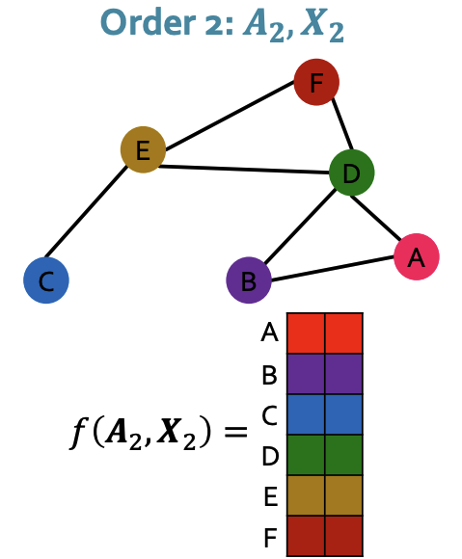
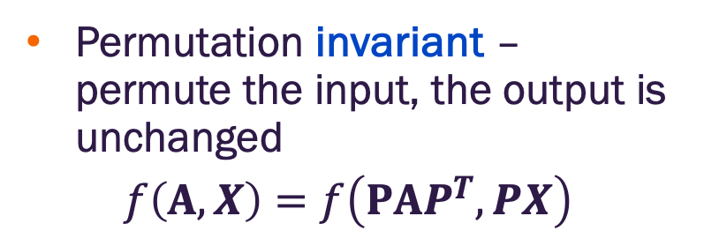
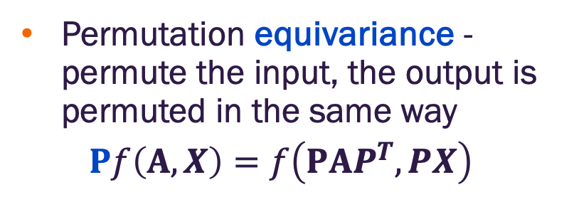
Permutation invariance and equivariance
Permutation invariant – permute the input, the output is unchanged
$$f\left(A,X\right)=f\left(PAP^{T},PX\right)$$
Permutation equivariance - permute the input, the output is permuted in the same way
$$Pf\left(A,X\right)=f\left(PAP^{T},PX\right)$$
Permutation invariance holds for node embeddings (can also hold for graph embeddings by aggregating over all node embeddings)
Permutation equivariance is property of the output embedding matrix
Image credit: Jure Leskovec, http://cs224w.stanford.edu

Slide 7
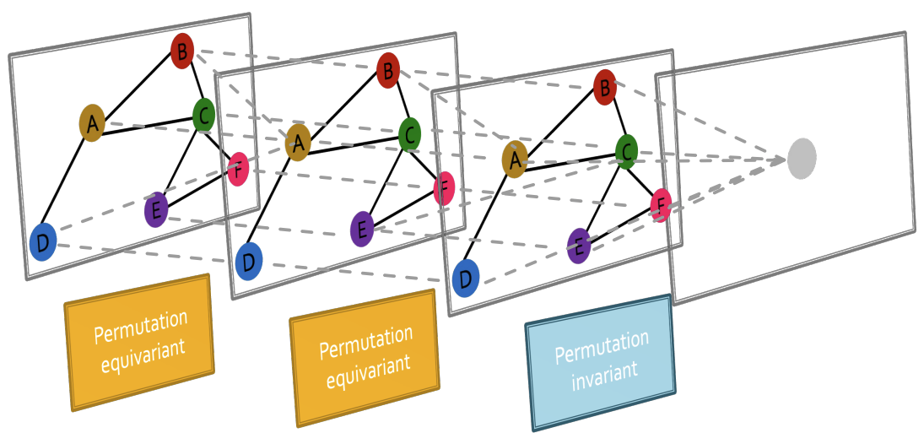
GNNs chain permutation invariant and equivariant operations
Image credit: Jure Leskovec, http://cs224w.stanford.edu

Slide 8
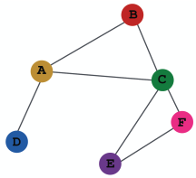
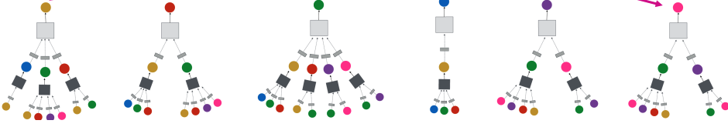
Neighbor node aggregation
Every neighborhood defines a computation graph
Input graph
Each node has a unique computation graph based on its neighborhood
Image credit: Jure Leskovec, http://cs224w.stanford.edu

Slide 9
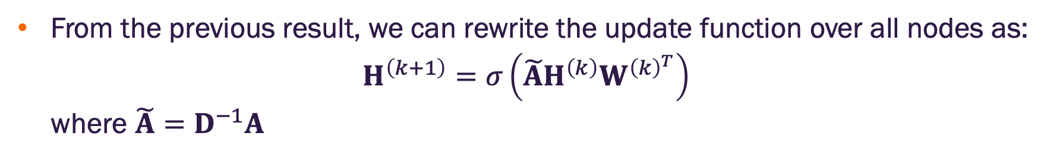
The math of graph convolution networks in matrix form
From the previous result, we can rewrite the update function over all nodes as:
$$H^{\left(k+1\right)}=σ\left(\tilde{A}H^{\left(k\right)}W^{{\left(k\right)}^{T}}\right)$$
where $\tilde{A}=D^{−1}A$
neighborhood
aggregation
normalization
Can we generalize this approach?

Slide 10
Message passing framework

Slide 11
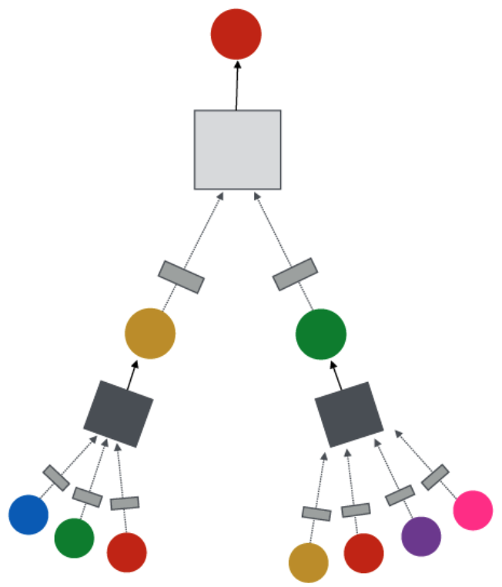
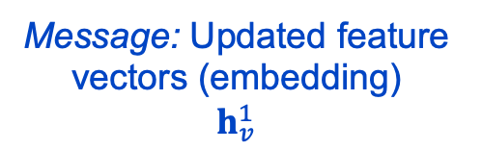
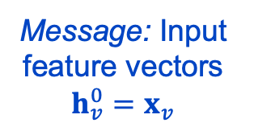
Message passing in GNNs
Target node
GNN Layer 2
Input graph
Message: Updated feature vectors (embedding)
$$h_{v}^{1}$$
Layer Operations
Neighborhood message aggregation
Node message (embedding) update
GNN Layer 1
Message: Input feature vectors $h_{v}^{0}=x_{v}$
Image credit: Jure Leskovec, http://cs224w.stanford.edu

Slide 12
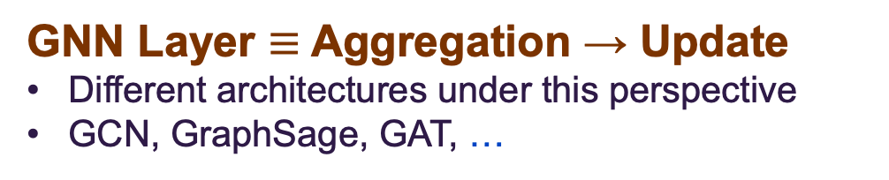
Message passing in GNNs
GNN Layer $≡$ Aggregation → Update
Different architectures under this perspective
GCN, GraphSage, GAT, …
Target node
GNN Layer 2
Input graph
Message: Updated feature vectors (embedding)
$$h_{v}^{1}$$
Layer Operations
Neighborhood message aggregation
Node message (embedding) update
GNN Layer 1
Message: Input feature vectors
$$h_{v}^{0}=x_{v}$$
Image credit: Jure Leskovec, http://cs224w.stanford.edu

Slide 13
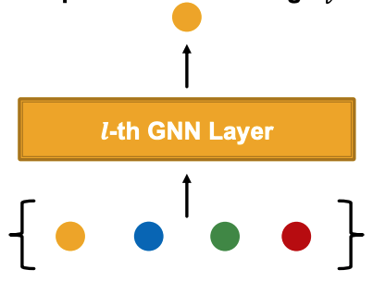
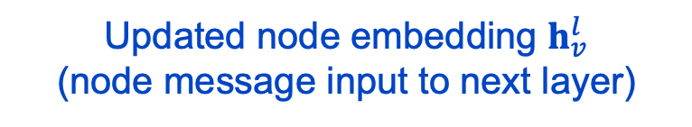
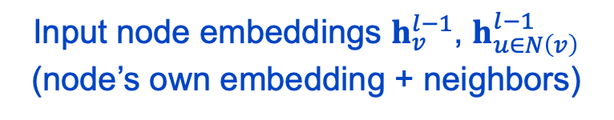
GNN layer concept
A single GNN layer
Main idea: Convert a set of input vectors into a single vector while maintaining permutation invariance (individual node embeddings) equivariance (output matrix of all node embeddings)
Two step process:
Node message aggregation
Node embedding update
Updated node embedding $h_{v}^{l}$
(node message input to next layer)
aggregation & update
messages
Input node embeddings $h_{v}^{l−1}$, $h_{u∈N\left(v\right)}^{l−1}$ (node’s own embedding + neighbors)
Image credit: Jure Leskovec, http://cs224w.stanford.edu

Slide 14
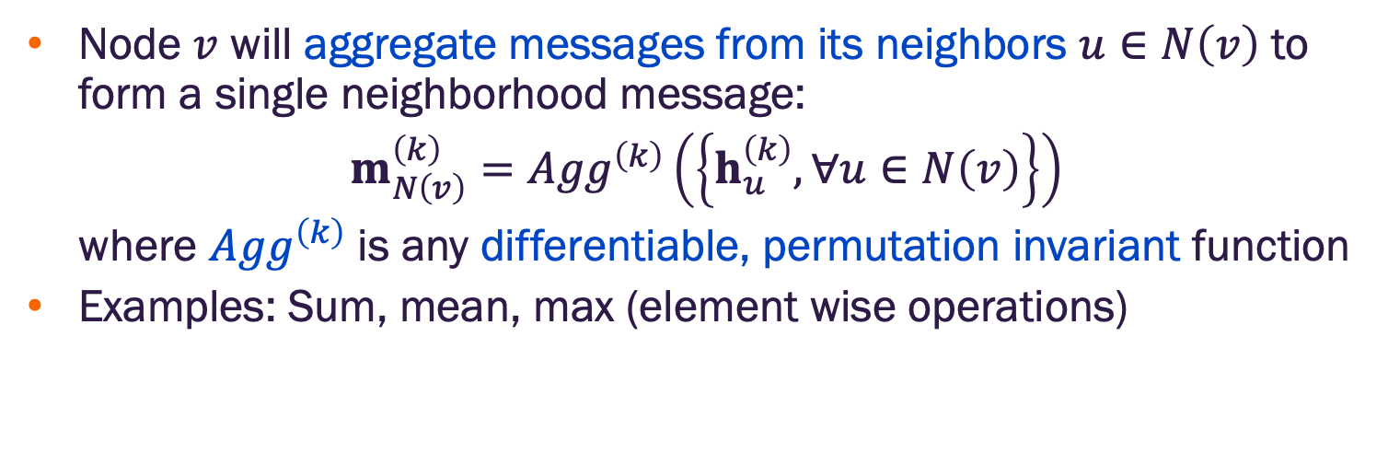
Node neighborhood message aggregation
Node $v$ will aggregate messages from its neighbors $u∈N\left(v\right)$ to form a single neighborhood message:
$$m_{N\left(v\right)}^{\left(k\right)}={Agg}^{\left(k\right)}\left(\left\{h_{u}^{\left(k\right)}, ∀u∈N\left(v\right)\right\}\right)$$
where ${Agg}^{\left(k\right)}$ is any differentiable, permutation invariant function
Examples: Sum, mean, max (element wise operations)
Aggregation
Messages
Image credit: Jure Leskovec, http://cs224w.stanford.edu

Slide 15
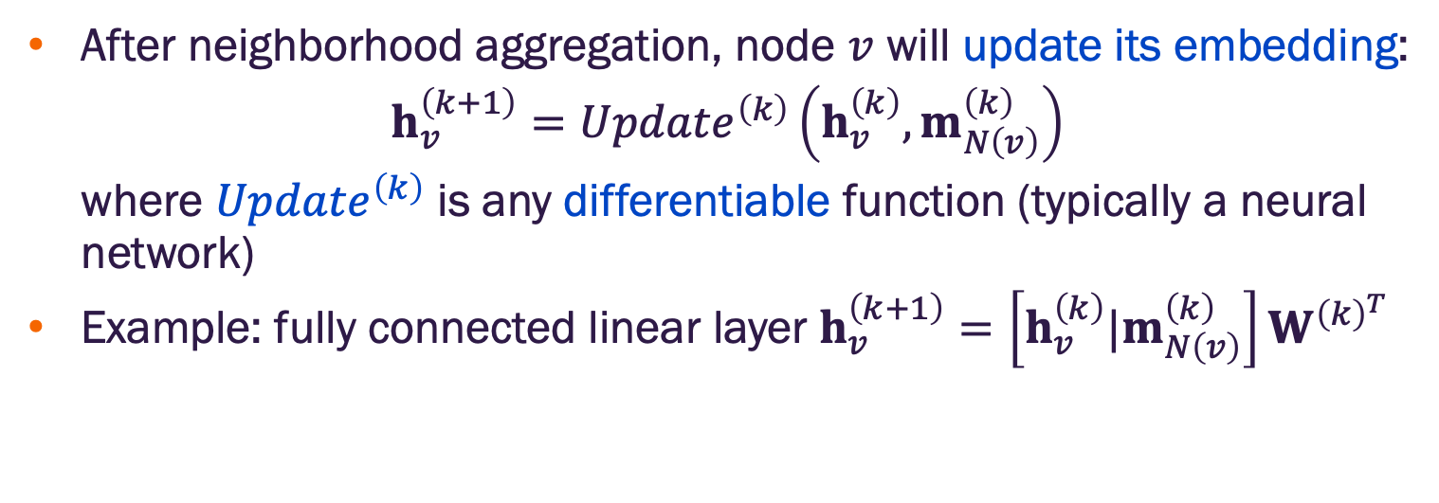
Node message (embedding) update
After neighborhood aggregation, node $v$ will update its embedding:
$$h_{v}^{\left(k+1\right)}={Update}^{\left(k\right)}\left({h_{v}^{\left(k\right)},m}_{N\left(v\right)}^{\left(k\right)}\right)$$
where ${Update}^{\left(k\right)}$ is any differentiable function (typically a neural network)
Example: fully connected linear layer $h_{v}^{\left(k+1\right)}=\left[{h_{v}^{\left(k\right)}|m}_{N\left(v\right)}^{\left(k\right)}\right]W^{{\left(k\right)}^{T}}$
update matrix
(linear layer)
vector concatenation
Updated message
Aggregation
Messages
Image credit: Jure Leskovec, http://cs224w.stanford.edu

Slide 16
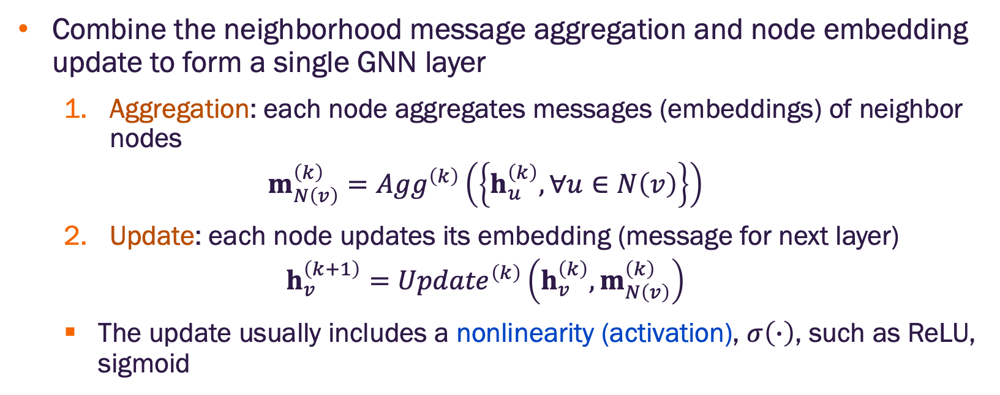
Message aggregation and update as a GNN layer
Combine the neighborhood message aggregation and node embedding update to form a single GNN layer
Aggregation: each node aggregates messages (embeddings) of neighbor nodes
$$m_{N\left(v\right)}^{\left(k\right)}={Agg}^{\left(k\right)}\left(\left\{h_{u}^{\left(k\right)}, ∀u∈N\left(v\right)\right\}\right)$$
Update: each node updates its embedding (message for next layer)
$$h_{v}^{\left(k+1\right)}={Update}^{\left(k\right)}\left({h_{v}^{\left(k\right)},m}_{N\left(v\right)}^{\left(k\right)}\right)$$
The update usually includes a nonlinearity (activation), $σ\left(∙\right)$, such as ReLU, sigmoid

Slide 17
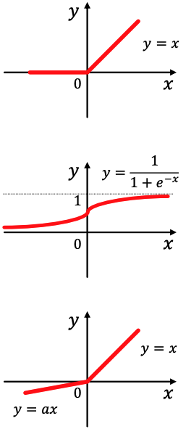
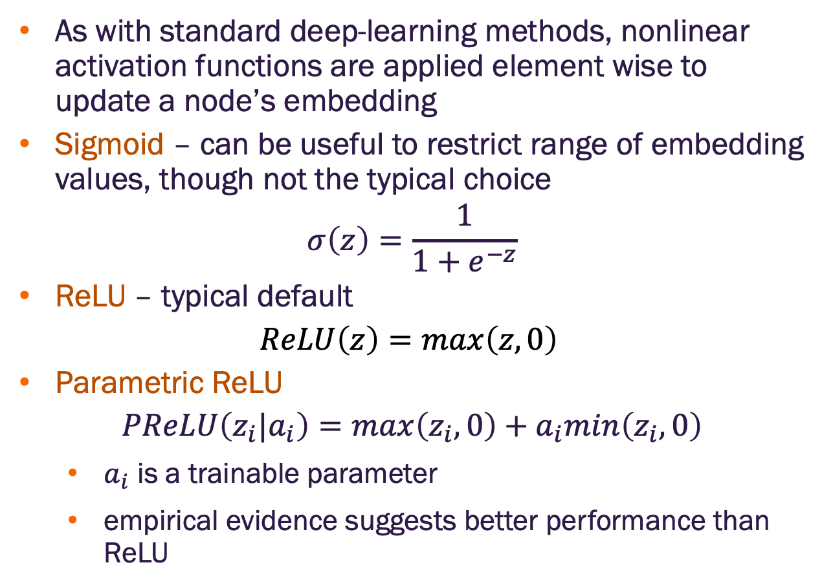
Nonlinear activation function review
As with standard deep-learning methods, nonlinear activation functions are applied element wise to update a node’s embedding
Sigmoid – can be useful to restrict range of embedding values, though not the typical choice
$$σ\left(z\right)=\frac{1}{1+e^{−z}}$$
ReLU – typical default
$$ReLU\left(z\right)=max\left(z,0\right)⁡$$
Parametric ReLU
$$PReLU\left(z_{i}|a_{i}\right)=max\left(z_{i},0\right)+a_{i}min\left(z_{i},0\right)$$
$a_{i}$ is a trainable parameter
empirical evidence suggests better performance than ReLU

Slide 18
GNNs in the message passing framework

Slide 19
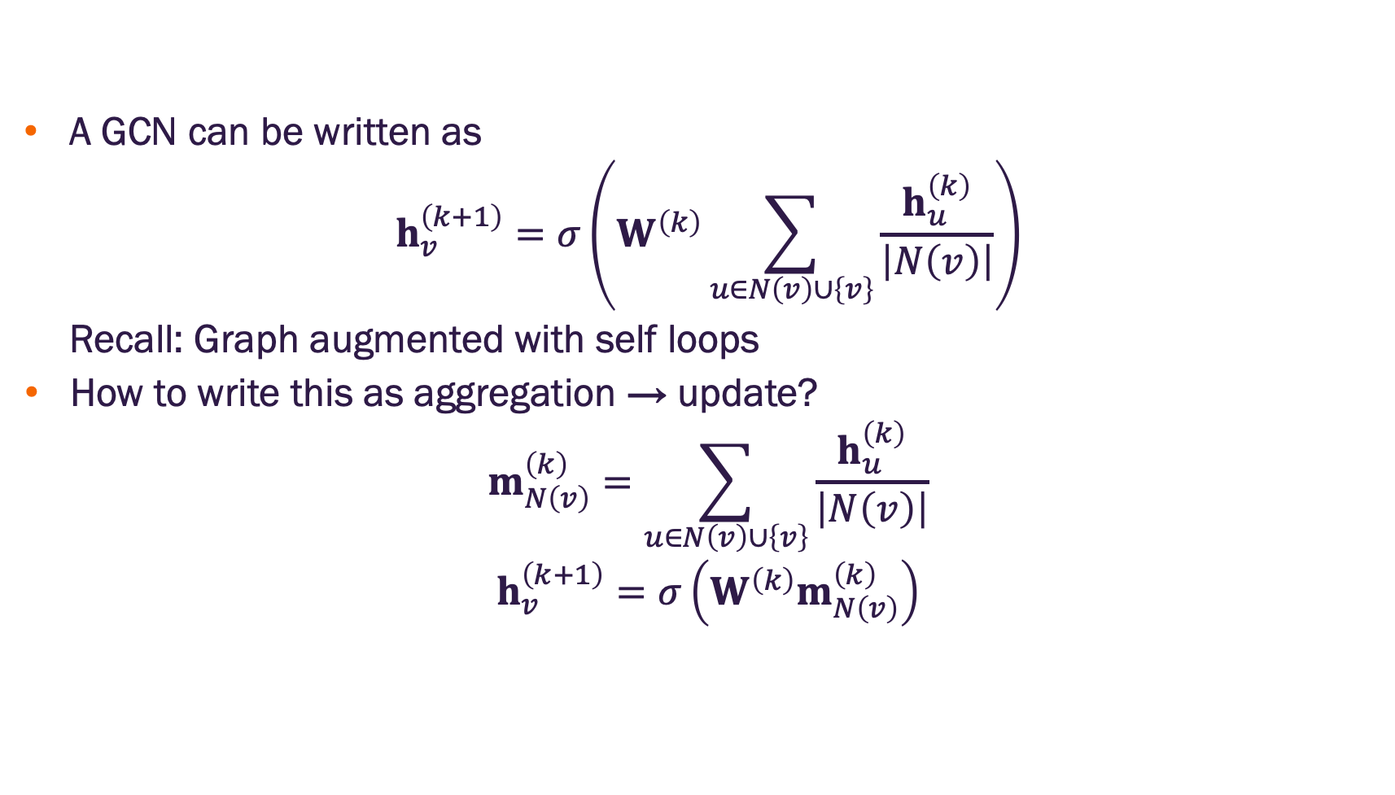
Graph convolutional networks
A GCN can be written as
$$h_{v}^{\left(k+1\right)}=σ\left(W^{\left(k\right)}\sum_{u∈N\left(v\right)∪\left\{v\right\}}{\frac{h_{u}^{\left(k\right)}}{\left|N\left(v\right)\right|}}\right)$$
Recall: Graph augmented with self loops
How to write this as aggregation → update?
$$m_{N\left(v\right)}^{\left(k\right)}=\sum_{u∈N\left(v\right)∪\left\{v\right\}}{\frac{h_{u}^{\left(k\right)}}{\left|N\left(v\right)\right|}}$$
$$h_{v}^{\left(k+1\right)}=σ\left(W^{\left(k\right)}m_{N\left(v\right)}^{\left(k\right)}\right)$$

Slide 20
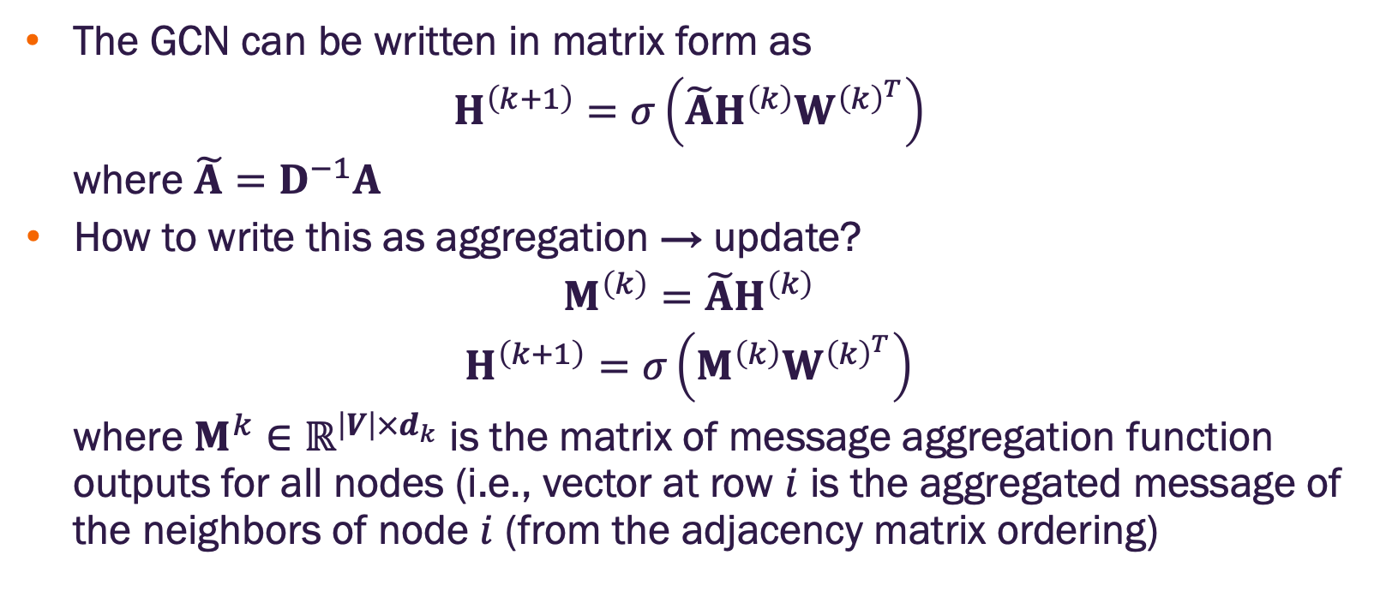
Graph convolution networks in matrix form
The GCN can be written in matrix form as
$$H^{\left(k+1\right)}=σ\left(\tilde{A}H^{\left(k\right)}W^{{\left(k\right)}^{T}}\right)$$
where $\tilde{A}=D^{−1}A$
How to write this as aggregation → update?
$$M^{\left(k\right)}=\tilde{A}H^{\left(k\right)}$$
$$H^{\left(k+1\right)}=σ\left(M^{\left(k\right)}W^{{\left(k\right)}^{T}}\right)$$
where $M^{k}∈ℝ^{\left|V\right|×d_{k}}$ is the matrix of message aggregation function outputs for all nodes (i.e., vector at row $i$ is the aggregated message of the neighbors of node $i$ (from the adjacency matrix ordering)

Slide 21
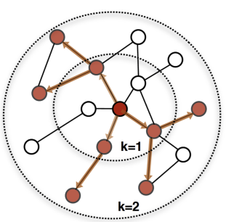
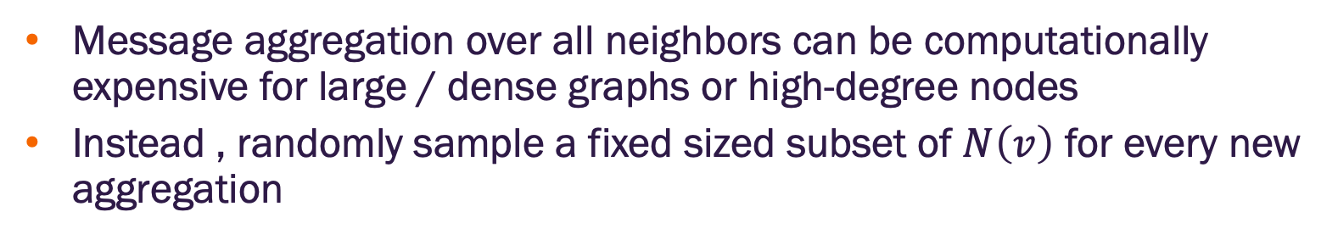
GraphSAGE (SAmple and aggreGatE) networks
Message aggregation over all neighbors can be computationally expensive for large / dense graphs or high-degree nodes
Instead , randomly sample a fixed sized subset of $N\left(v\right)$ for every new aggregation
Image credit: Hamilton, Ying, Leskovec 2018

Slide 22
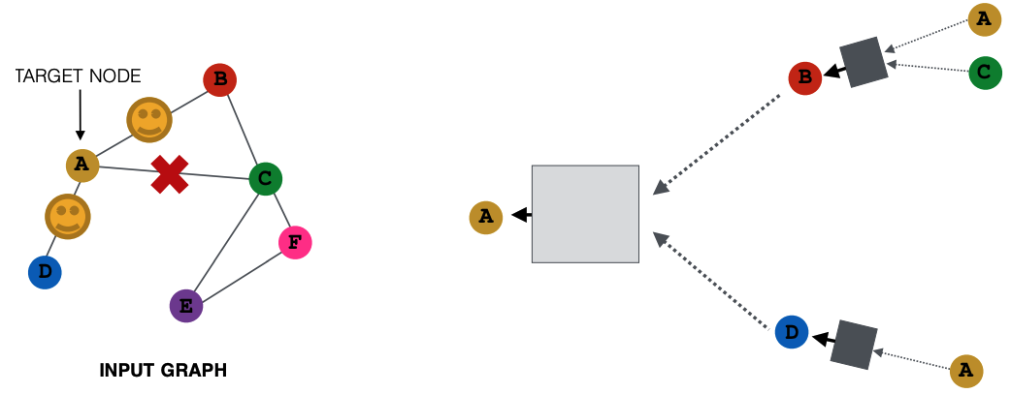
GraphSAGE (SAmple and aggreGatE) sampling
For example, sample two (2) neighbors for message aggregation
Here, only nodes B and D pass messages to A
Image credit: Jure Leskovec, http://cs224w.stanford.edu

Slide 23
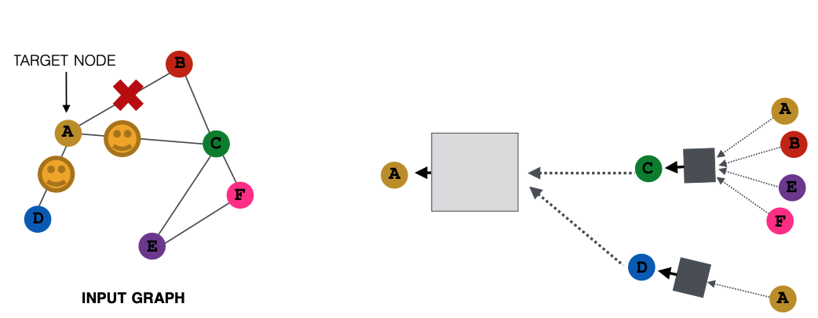
GraphSAGE (SAmple and aggreGatE) sampling
For the next embedding update (layer, training batch, new sample), we can sample different neighbors
Here, only nodes C and D pass messages to A
Image credit: Jure Leskovec, http://cs224w.stanford.edu

Slide 24
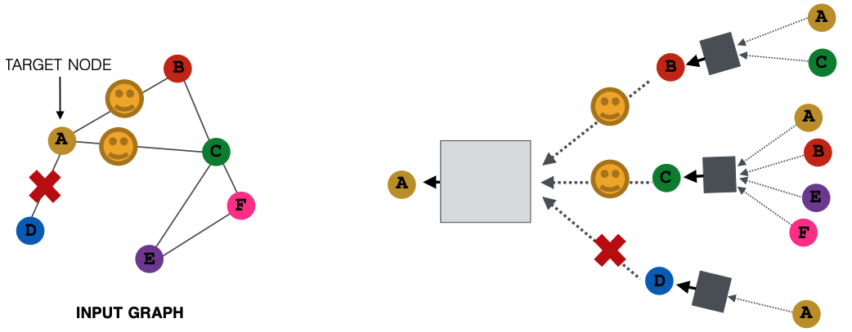
GraphSAGE (SAmple and aggreGatE) sampling
In expectation (on average), we get embeddings similar to aggregating over all neighbors
Greatly reduces computational cost
Image credit: Jure Leskovec, http://cs224w.stanford.edu

Slide 25
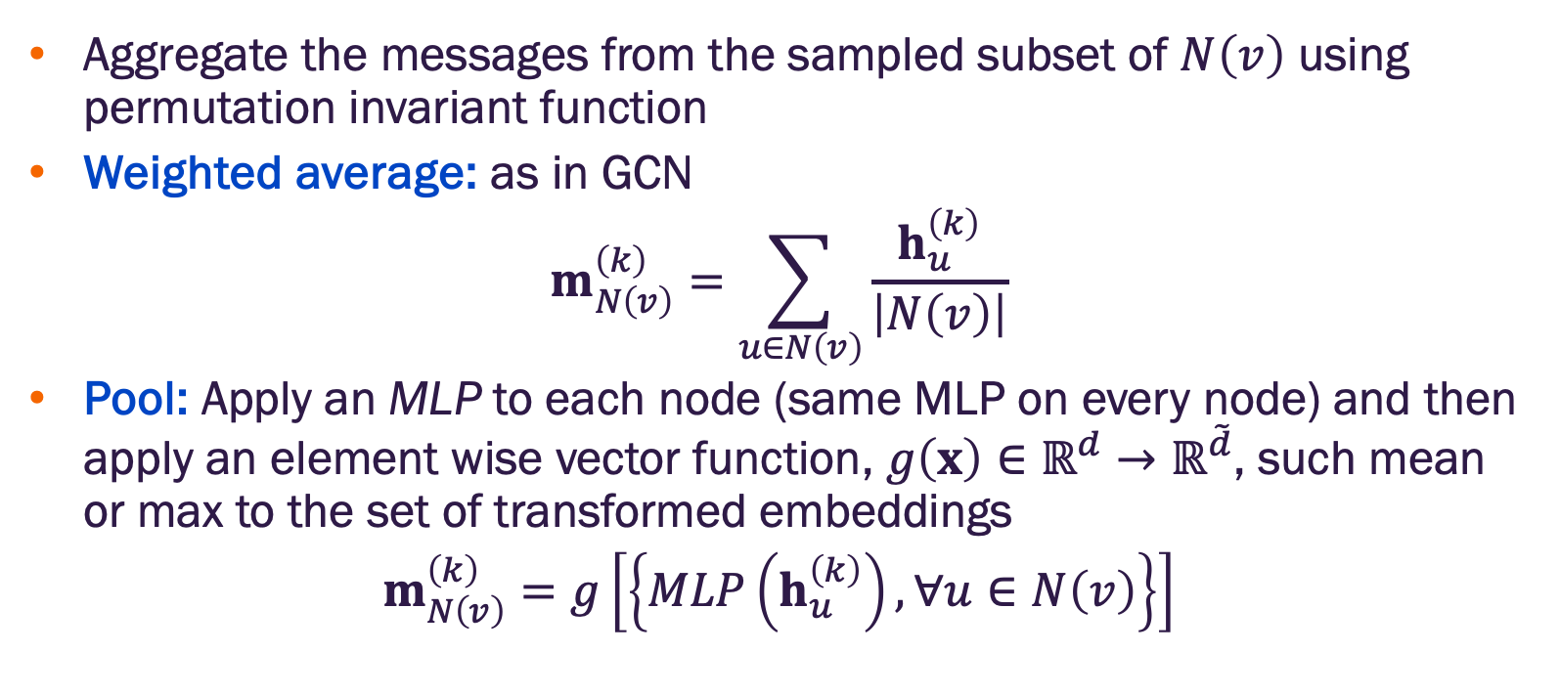
GraphSAGE node message aggregation
Aggregate the messages from the sampled subset of $N\left(v\right)$ using permutation invariant function
Weighted average: as in GCN
$$m_{N\left(v\right)}^{\left(k\right)}=\sum_{u∈N\left(v\right)}{\frac{h_{u}^{\left(k\right)}}{\left|N\left(v\right)\right|}}$$
Pool: Apply an MLP to each node (same MLP on every node) and then apply an element wise vector function, $g\left(x\right)∈ℝ^{d}→ℝ^{\tilde{d}}$, such mean or max to the set of transformed embeddings
$$m_{N\left(v\right)}^{\left(k\right)}=g\left[\left\{MLP\left(h_{u}^{\left(k\right)}\right), ∀u∈N\left(v\right)\right\}\right]$$

Slide 26
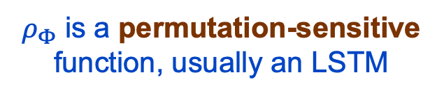
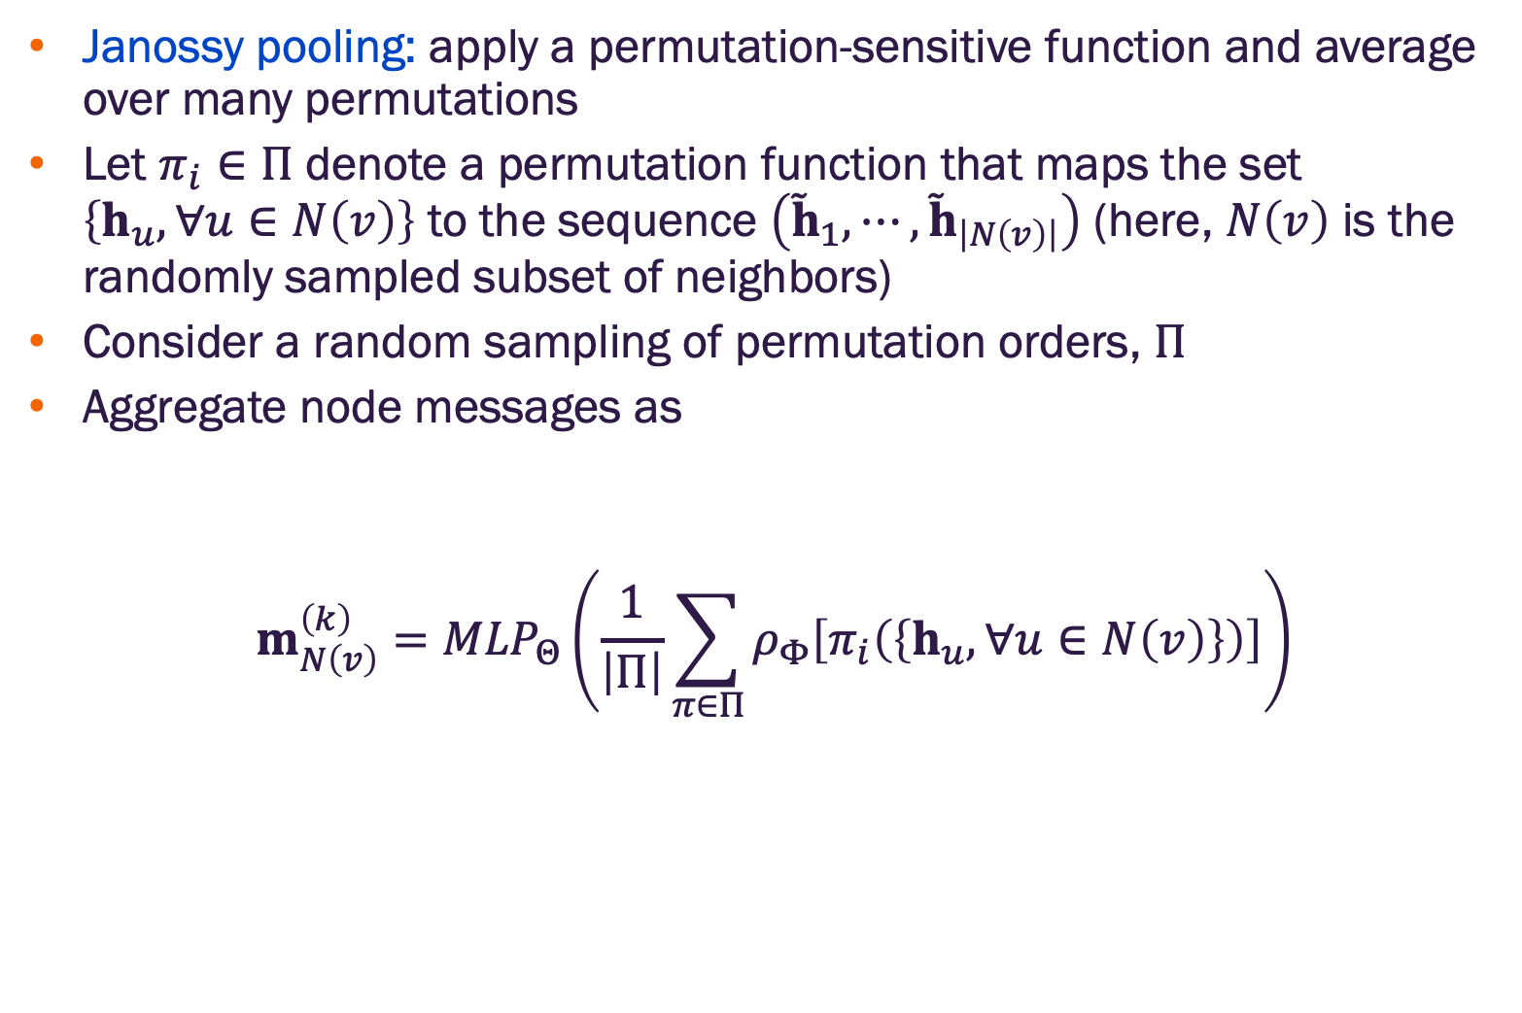
GraphSAGE node message aggregation
Janossy pooling: apply a permutation-sensitive function and average over many permutations
Let $π_{i}∈Π$ denote a permutation function that maps the set $\left\{h_{u}, ∀u∈N\left(v\right)\right\}$ to the sequence $\left({\tilde{h}}_{1},⋯,{\tilde{h}}_{\left|N\left(v\right)\right|}\right)$ (here, $N\left(v\right)$ is the randomly sampled subset of neighbors)
Consider a random sampling of permutation orders, $Π$
Aggregate node messages as
$$m_{N\left(v\right)}^{\left(k\right)}={MLP}_{Θ}\left(\frac{1}{\left|Π\right|}\sum_{π∈Π}{ρ_{Φ}\left[π_{i}\left(\left\{h_{u}, ∀u∈N\left(v\right)\right\}\right)\right]}\right)$$
$ρ_{Φ}$ is a permutation-sensitive function, usually an LSTM
sum over multiple permutations

Slide 27
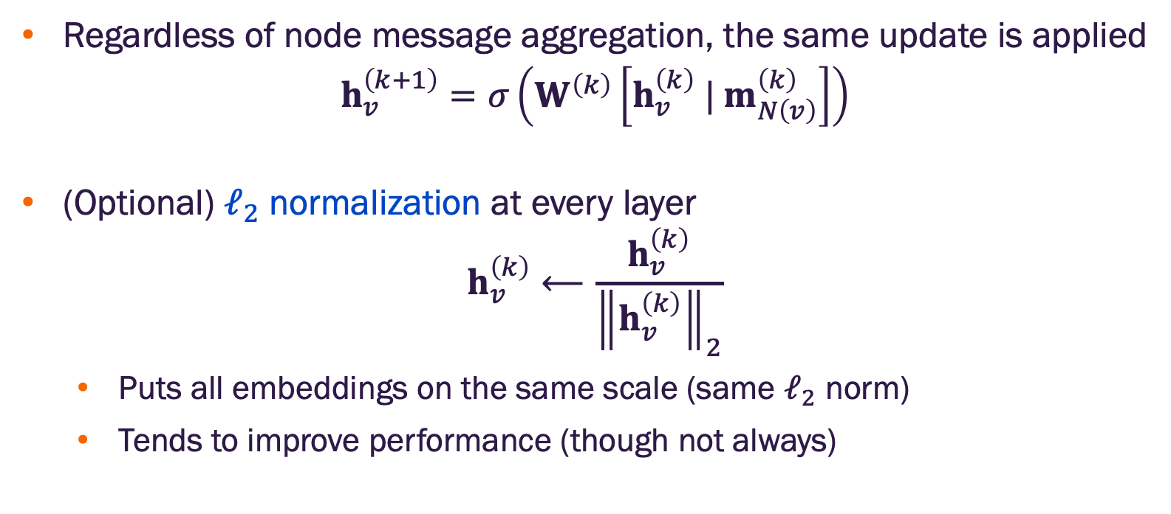
GraphSAGE embedding update
Regardless of node message aggregation, the same update is applied
$$h_{v}^{\left(k+1\right)}=σ\left(W^{\left(k\right)}\left[{h_{v}^{\left(k\right)} | m}_{N\left(v\right)}^{\left(k\right)}\right]\right)$$
(Optional) $ℓ_{2}$ normalization at every layer
$$h_{v}^{\left(k\right)}⟵\frac{h_{v}^{\left(k\right)}}{{\left\|h_{v}^{\left(k\right)}\right\|}_{2}}$$
Puts all embeddings on the same scale (same $ℓ_{2}$ norm)
Tends to improve performance (though not always)
vector concatenation with node’s previous layer embedding

Slide 28
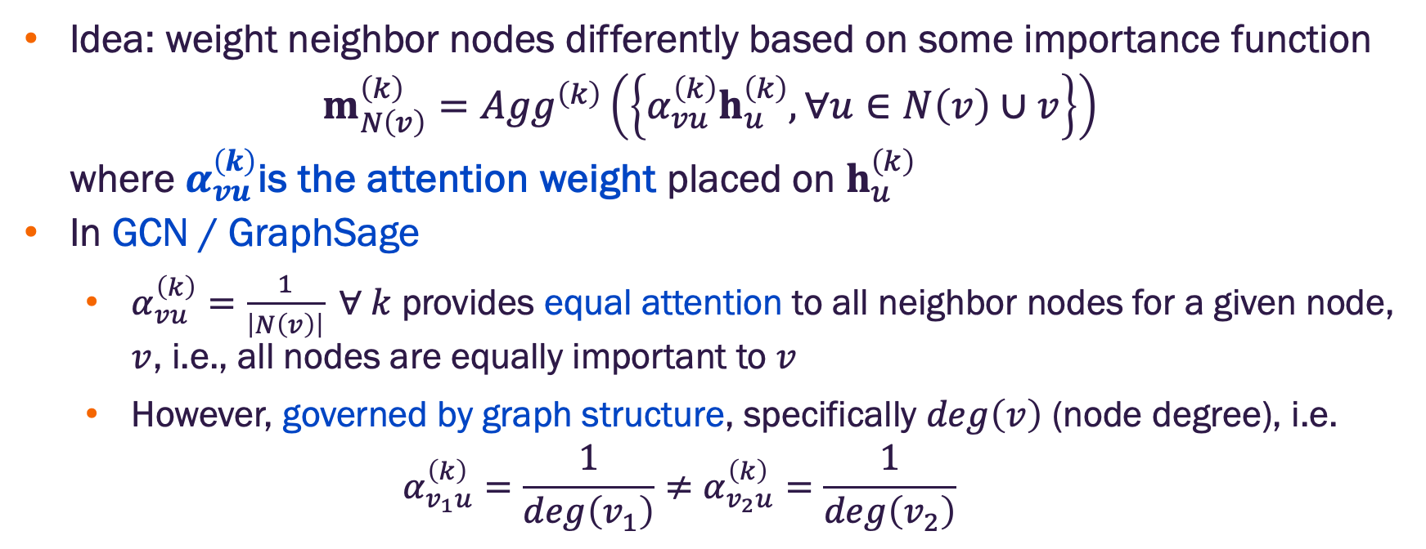
Graph attention networks
Idea: weight neighbor nodes differently based on some importance function
$$m_{N\left(v\right)}^{\left(k\right)}={Agg}^{\left(k\right)}\left(\left\{α_{vu}^{\left(k\right)}h_{u}^{\left(k\right)}, ∀u∈N\left(v\right)∪v\right\}\right)$$
where $α_{vu}^{\left(k\right)}$is the attention weight placed on $h_{u}^{\left(k\right)}$
In GCN / GraphSage
$α_{vu}^{\left(k\right)}=\frac{1}{\left|N\left(v\right)\right|} ∀ k$ provides equal attention to all neighbor nodes for a given node, $v$, i.e., all nodes are equally important to $v$
However, governed by graph structure, specifically $deg\left(v\right)$ (node degree), i.e.
$$α_{v_{1}u}^{\left(k\right)}=\frac{1}{deg\left(v_{1}\right)}≠α_{v_{2}u}^{\left(k\right)}=\frac{1}{deg\left(v_{2}\right)}$$

Slide 29
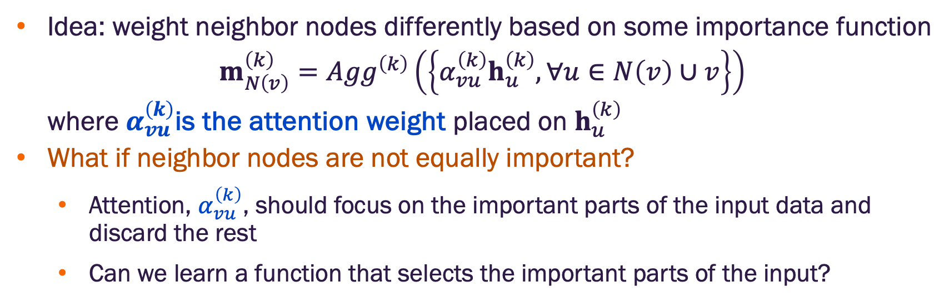
Graph attention networks
Idea: weight neighbor nodes differently based on some importance function
$$m_{N\left(v\right)}^{\left(k\right)}={Agg}^{\left(k\right)}\left(\left\{α_{vu}^{\left(k\right)}h_{u}^{\left(k\right)}, ∀u∈N\left(v\right)∪v\right\}\right)$$
where $α_{vu}^{\left(k\right)}$is the attention weight placed on $h_{u}^{\left(k\right)}$
What if neighbor nodes are not equally important?
Attention, $α_{vu}^{\left(k\right)}$, should focus on the important parts of the input data and discard the rest
Can we learn a function that selects the important parts of the input?

Slide 30
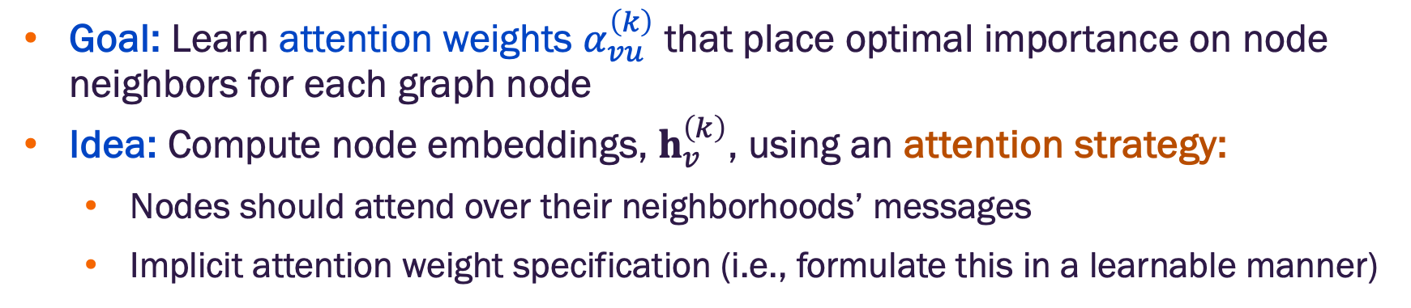
Graph attention networks
Goal: Learn attention weights $α_{vu}^{\left(k\right)}$ that place optimal importance on node neighbors for each graph node
Idea: Compute node embeddings, $h_{v}^{\left(k\right)}$, using an attention strategy:
Nodes should attend over their neighborhoods’ messages
Implicit attention weight specification (i.e., formulate this in a learnable manner)

Slide 31
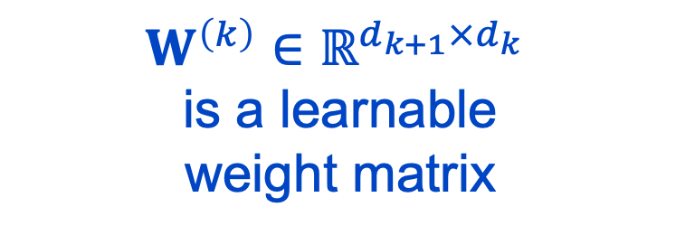
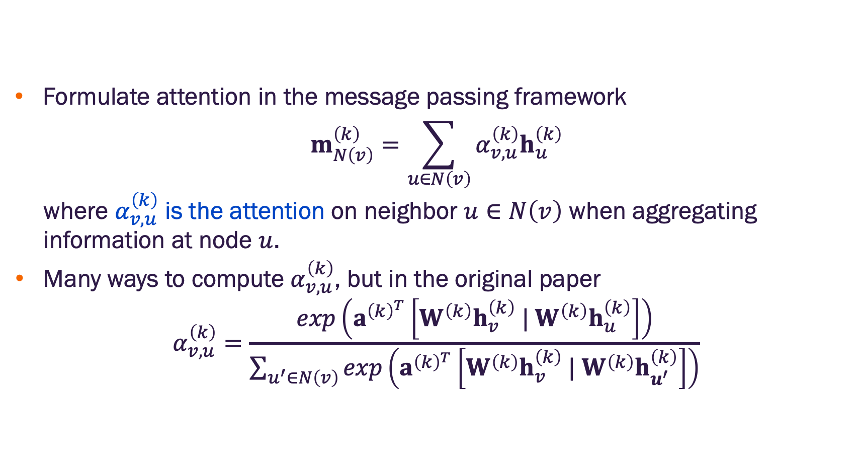
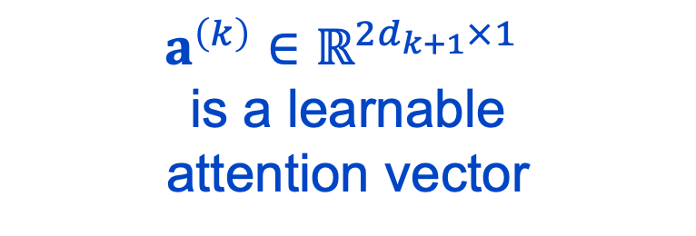
Graph attention networks message aggregation + attention
Formulate attention in the message passing framework
$$m_{N\left(v\right)}^{\left(k\right)}=\sum_{u∈N\left(v\right)}{α_{v,u}^{\left(k\right)}h_{u}^{\left(k\right)}}$$
where $α_{v,u}^{\left(k\right)}$ is the attention on neighbor $u∈N\left(v\right)$ when aggregating information at node $u$.
Many ways to compute $α_{v,u}^{\left(k\right)}$, but in the original paper
$$α_{v,u}^{\left(k\right)}=\frac{exp\left(a^{{\left(k\right)}^{T}}\left[W^{\left(k\right)}h_{v}^{\left(k\right)} | W^{\left(k\right)}h_{u}^{\left(k\right)}\right]\right)}{\sum_{u^{′}∈N\left(v\right)}{exp\left(a^{{\left(k\right)}^{T}}\left[W^{\left(k\right)}h_{v}^{\left(k\right)} | W^{\left(k\right)}h_{u^{′}}^{\left(k\right)}\right]\right)}}$$
scalar attention
$a^{\left(k\right)}∈ℝ^{{2d}_{k+1}×1}$
is a learnable
attention vector
$$W^{\left(k\right)}∈ℝ^{d_{k+1}×d_{k}}$$
is a learnable
weight matrix

Slide 32
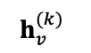
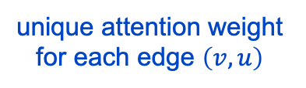
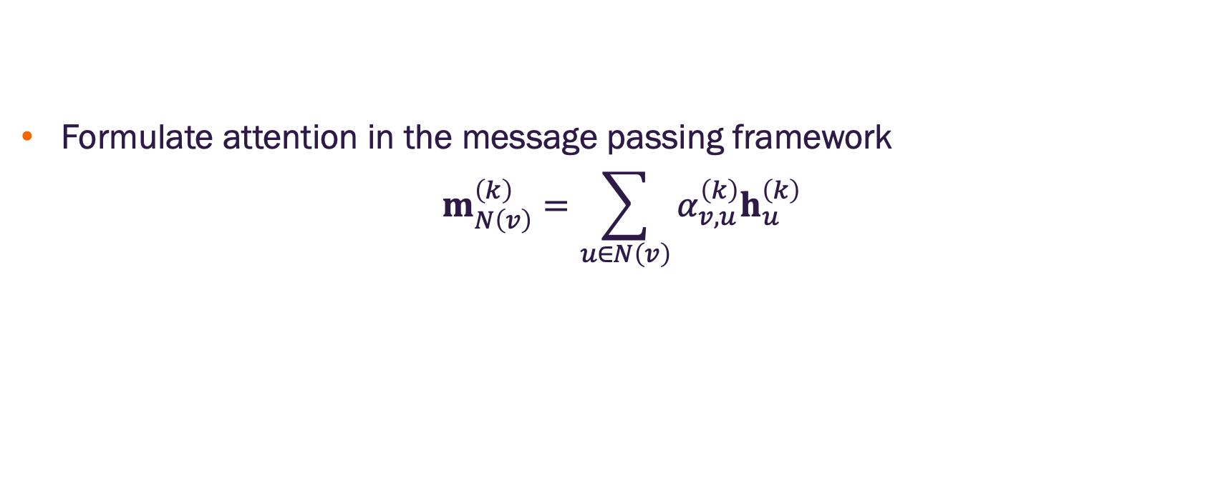
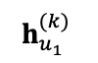
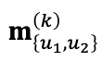

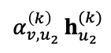

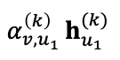

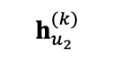
Graph attention networks message aggregation + attention
Formulate attention in the message passing framework
$$m_{N\left(v\right)}^{\left(k\right)}=\sum_{u∈N\left(v\right)}{α_{v,u}^{\left(k\right)}h_{u}^{\left(k\right)}}$$
Message
Aggregation w/ Attention
attention weighting
$$h_{u_{1}}^{(k)}$$
summation
$$h_{v}^{(k)}$$
$$u_{1}$$
$${α_{v,u_{1} }^{\left(k\right)}h}_{u_{1}}^{(k)}$$
$$v$$
target node
$$m_{\left\{u_{1},u_{2}\right\}}^{\left(k\right)}$$
$${α_{v,u_{2} }^{\left(k\right)}h}_{u_{2}}^{(k)}$$
$$u_{2}$$
$$h_{u_{2}}^{(k)}$$
unique attention weight for each edge $\left(v,u\right)$

Slide 33
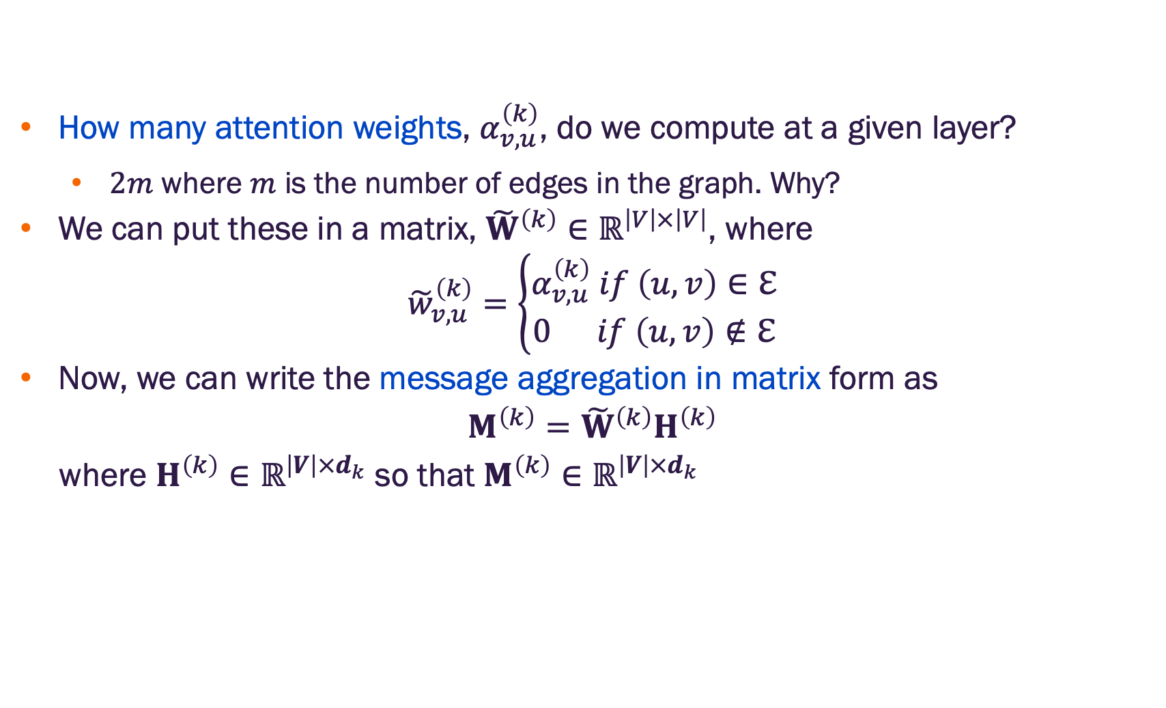
Graph attention message aggregation in matrix form
How many attention weights, $α_{v,u}^{\left(k\right)}$, do we compute at a given layer?
$2m$ where $m$ is the number of edges in the graph. Why?
We can put these in a matrix, ${\tilde{W}}^{\left(k\right)}∈ℝ^{\left|V\right|×\left|V\right|}$, where
$${\tilde{w}}_{v,u}^{\left(k\right)}=\left\{\begin{aligned}α_{v,u}^{\left(k\right)} if \left(u,v\right)∈ℇ \\ 0 if \left(u,v\right)∉ℇ\end{aligned}\right.$$
Now, we can write the message aggregation in matrix form as
$$M^{\left(k\right)}={\tilde{W}}^{\left(k\right)}H^{\left(k\right)}$$
where $H^{\left(k\right)}∈ℝ^{\left|V\right|×d_{k}}$ so that $M^{\left(k\right)}∈ℝ^{\left|V\right|×d_{k}}$
This formulation assumes the attention weights have already been computed.

Slide 34


Graph attention with convolution update
Assuming we have the message aggregation in matrix
$$M^{\left(k\right)}={\tilde{W}}^{\left(k\right)}H^{\left(k\right)}∈ℝ^{\left|V\right|×d_{k}}$$
we update the node embeddings via any differentiable update function
$$H^{\left(k+1\right)}={Update}^{\left(k\right)}\left(H^{\left(k+1\right)},M^{\left(k\right)}\right)$$
The typical update function applies the same approach as graph convolution networks
$$H^{\left(k+1\right)}=M^{\left(k\right)}W^{{\left(k\right)}^{T}}∈ℝ^{\left|V\right|×d_{k+1}}$$
This is the same $W^{\left(k\right)}$ used in the attention weight computations

Slide 35













Graph attention with convolution update
Formulate attention in the message passing framework
$$m_{N\left(v\right)}^{\left(k\right)}=\sum_{u∈N\left(v\right)}{α_{v,u}^{\left(k\right)}h_{u}^{\left(k\right)}}$$
$$h^{\left(k+1\right)}=m_{N\left(v\right)}^{\left(k\right)}W^{{\left(k\right)}^{T}}$$
Message
Aggregation w/ Attention
attention weighting
$$h_{u_{1}}^{(k)}$$
summation
$$h_{v}^{(k)}$$
$$u_{1}$$
$${α_{v,u_{1} }^{\left(k\right)}h}_{u_{1}}^{(k)}$$
Update
$$v$$
target node
$$m_{\left\{u_{1},u_{2}\right\}}^{\left(k\right)}$$
$$h_{v}^{\left(k+1\right)}=m_{\left\{u_{1},u_{2}\right\}}^{\left(k\right)}W^{{\left(k\right)}^{T}}$$
$${α_{v,u_{2} }^{\left(k\right)}h}_{u_{2}}^{(k)}$$
$$u_{2}$$
$$h_{u_{2}}^{(k)}$$
same $W^{\left(k\right)}$ used in the attention weight computations
unique attention weight for each edge $\left(v,u\right)$

Slide 36

Graph attention with convolution update layer
Putting it all together, graph attention with convolution update involves the following steps at each layer:
Compute the attention weights
$$α_{v,u}^{\left(k\right)}=\frac{exp\left(a^{{\left(k\right)}^{T}}\left[W^{\left(k\right)}h_{v}^{\left(k\right)} | W^{\left(k\right)}h_{u}^{\left(k\right)}\right]\right)}{\sum_{u^{′}∈N\left(v\right)}{exp\left(a^{{\left(k\right)}^{T}}\left[W^{\left(k\right)}h_{v}^{\left(k\right)} | W^{\left(k\right)}h_{u^{′}}^{\left(k\right)}\right]\right)}}$$
Aggregate node messages with attention weighting
$m_{N\left(v\right)}^{\left(k\right)}=\sum_{u∈N\left(v\right)}{α_{v,u}^{\left(k\right)}h_{u}^{\left(k\right)}}$ → $M^{\left(k\right)}={\tilde{W}}^{\left(k\right)}H^{\left(k\right)}$
Update node embeddings
$h_{v}^{\left(k+1\right)}=m_{N\left(v\right)}^{\left(k\right)}W^{{\left(k\right)}^{T}}$→ $H^{\left(k+1\right)}=M^{\left(k\right)}W^{{\left(k\right)}^{T}}∈ℝ^{\left|V\right|×d_{k+1}}$

Slide 37



Multi-head graph attention
Use $H$ different attention heads to aggregate messages
Results in $H$ different messages, one for each attention head, $h∈\left[1,H\right]$
Stabilizes attention mechanism learning
$m_{N\left(v\right)}^{\left(k,h\right)}=\sum_{u∈N\left(v\right)}{α_{v,u}^{\left(k,h\right)}h_{u}^{\left(k\right)}}$
where
$$α_{v,u}^{\left(k\right)}=\frac{exp\left(a^{{\left(k,h\right)}^{T}}\left[W^{\left(k,h\right)}h_{v}^{\left(k\right)} | W^{\left(k,h\right)}h_{u}^{\left(k\right)}\right]\right)}{\sum_{u^{′}∈N\left(v\right)}{exp\left(a^{{\left(k,h\right)}^{T}}\left[W^{\left(k,h\right)}h_{v}^{\left(k\right)} | W^{\left(k,h\right)}h_{u^{′}}^{\left(k\right)}\right]\right)}}$$
$a^{\left(k,h\right)}∈ℝ^{{2d}_{k+1}×1}$
different attention vector for each attention head
$$W^{\left(k,h\right)}∈ℝ^{d_{k+1}×d_{k}}$$
different weight matrix for each attention head

Slide 38

Multi-head graph attention with convolution update
Aggregated message from each attention head is updated individually
Updates are aggregated (e.g., concatenation or summation) to form new embedding for node $v$
$m_{N\left(v\right)}^{\left(k,h\right)}=\sum_{u∈N\left(v\right)}{α_{v,u}^{\left(k,h\right)}h_{u}^{\left(k\right)}}$
$$h^{\left(k+1,h\right)}=m_{N\left(v\right)}^{\left(k,h\right)}W^{{\left(k,h\right)}^{T}}$$
$$h^{\left(k+1\right)}=\sum_{h}{h^{\left(k+1,h\right)}}$$

Slide 39















Multi-head graph attention with convolution update
Here, assume we have two attention heads
attention weighting
First attention head
summation
Update
$${α_{v,u_{1} }^{\left(k,1\right)}h}_{u_{1}}^{(k)}$$
$${h_{v}^{(k+1,1)}=m}_{\left\{u_{1},u_{2}\right\}}^{\left(k,1\right)}W^{{\left(k,1\right)}^{T}}$$
$$h_{u_{1}}^{(k)}$$
$$m_{\left\{u_{1},u_{2}\right\}}^{\left(k,1\right)}$$
$$h_{v}^{(k)}$$
$${α_{v,u_{2} }^{\left(k,1\right)}h}_{u_{2}}^{(k)}$$
$$u_{1}$$
Aggregation
$$v$$
target node
$$h_{v}^{(k+1)}=\sum_{h}{h_{v}^{(k+1,h)}}$$
attention weighting
$$u_{2}$$
Second attention head
summation
Update
$$h_{u_{2}}^{(k)}$$
$${α_{v,u_{1} }^{\left(k,2\right)}h}_{u_{1}}^{(k)}$$
$${h_{v}^{(k+1,2)}=m}_{\left\{u_{1},u_{2}\right\}}^{\left(k,1\right)}W^{{\left(k,2\right)}^{T}}$$
$$m_{\left\{u_{1},u_{2}\right\}}^{\left(k,2\right)}$$
$${α_{v,u_{2} }^{\left(k,2\right)}h}_{u_{2}}^{(k)}$$

Slide 40

Benefits of Attention
Key benefit: Allows for implicitly specifying different importance values for each neighbor node
Computational efficiency
Attention weights can be computed in parallel across all graph edges
Aggregation can by parallelized across all nodes
Storage efficient
Sparse matrix operations require $≤O\left(V+ℇ\right)$ storage
Fixed number of model parameters independent of graph size (node count)
A note about implementation:
The message passing framework is useful for conceptual understanding of GNNs
In practice, many of the matrix operations are implemented in ways that mix aspects of neighbor node aggregation and node update for efficiency

Slide 41
Applicable deep learning tools

Slide 42

A GNN layer in practice
We often want to use familiar deep learning modules to create our GNN layers
Batch normalization – stabilize network training
Dropout – prevent overfitting
Many other useful deep learning modules

Slide 43







Batch normalization
Goal: stabilize network training
Approach: Given a batch of $N$ inputs (e.g., node embeddings)
Recenter the embeddings to zero mean
Rescale the embeddings to unit variance
Input: $X∈ℝ^{N×d}$
Step 1:
Compute the mean and variance for each latent feature (embedding column $j$) over the $N$ embeddings
$$u_{j}=\frac{1}{N}\sum_{i=1}^{N}{x_{i,j}}$$
$σ_{j}^{2}=$ $\frac{1}{N}\sum_{i=1}^{N}{{\left(x_{i,j}−μ_{j}\right)}^{2}}$
Learnable Parameters:
$$γ,β∈ℝ^{d}$$
Output: $Y∈ℝ^{N×d}$
Step 2:
Normalize the embedding feature
$${\hat{x}}_{i,j}=\frac{x_{ij}−μ_{j}}{\sqrt{σ_{j}^{2}+∈}}$$
$$y_{i,j}=γ_{j}{\hat{x}}_{i,j}+β_{j}$$

Slide 44


Dropout regularization in standard neural networks
Regularize a deep neural network to prevent overfitting
Approach
During training: with some probability $p$, randomly turn off network neurons (i.e., set output to zero)
During test / deployment: use all neurons
Image credit: Jure Leskovec, http://cs224w.stanford.edu

Slide 45






Dropout regularization in GNNs
In a GNN, dropout is applied in the update function
Example, in GCN the update for node $v$ is $h_{v}^{\left(k+1\right)}=σ\left(W^{\left(k\right)}m_{N\left(v\right)}^{\left(k\right)}\right)$
Dropout implemented by removing neurons in$W^{\left(k\right)}$
$$W^{\left(k\right)}$$
Dropout removes latent features from the aggregated message, NOT nodes in the graph
$$m_{N\left(v\right)}^{\left(k\right)}$$
$$h_{v}^{\left(k+1\right)}$$
Image credit: Jure Leskovec, http://cs224w.stanford.edu

Slide 46
GNN layers in practice
Modern deep learning modules are useful in developing practical GNN layers
Designing novel GNN layers is an active research domain

Slide 47
Stacking GNN layers

Slide 48





Stacking GNN layers
How do we construct a GNN with multiple layers?
Standard approach is to stack layers sequentially
Initial input: $h_{v}^{\left(0\right)}=x_{v}$ is the input feature vector for $v$
Output: Node embedding $h_{v}^{\left(K\right)}$ after $K$ layers
$h_{v}^{\left(0\right)}=x_{v}$
GNN layer
$$h_{v}^{\left(1\right)}$$
GNN layer
$$h_{v}^{\left(K−1\right)}$$
GNN layer
$$h_{v}^{\left(K\right)}$$

Slide 49
Over-smoothing in deep GNNs
Stacking many GNN layers can cause over-smoothing
Over-smoothing occurs when all node embeddings converge to the same value – i.e., all embedding vectors are the same
Why does this happen?

Slide 50


Receptive field of a GNN
Receptive field: the set of nodes that contribute to the aggregated neighborhood message for a node of interest
In a $K$-layer GNN, each node has a receptive field of its $K$-hop neighborhood
Image credit: Jure Leskovec, http://cs224w.stanford.edu

Slide 51

Receptive field of a GNN
Receptive field overlap for two nodes
The shared neighbors quickly grows when increasing the field hop size (i.e., number of GNN layers)
Results in very similar messages being input to each node’s update function, yielding similar embeddings for both
Image credit: Jure Leskovec, http://cs224w.stanford.edu

Slide 52
Addressing over-smoothing
Be conservative with adding GNN layers – adding too many layers will cause over-smoothing
Analyze the receptive field necessary for your problem (e.g., by computing the network diameter – longest shortest path)
Set the number of GNN layers to be slightly more (say plus 1-3) than the estimated receptive field requirement
How can we enhance the expressive power of a GNN if the receptive field requirement limits the model to a small number of GNN layers?

Slide 53
Increasing expressive power for GNNs
Increase the expressive power within the GNN layer
In the GNN layers we discussed (GCN, GraphSAGE, GAT), the aggregations and transformations only include one linear layer
We can add layers to these to form a deeper network with the layer – this does not change the receptive field
The aggregation and updates can use an MLP
Updated message
Aggregation
Messages
Image credit: Jure Leskovec, http://cs224w.stanford.edu

Slide 54

Increasing expressive power for GNNs
Add network layers that do not pass messages
The overall network can contain non-message passing (GNN) layers
Example: add MLP layers before and after GNN layers to pre/post process next/prior layer output
Pre-processing: important when encoding features is necessary (e.g., when nodes represent images or text)
Post-processing: important when reasoning / transformation over node embeddings is required (e.g., graph classification)
Image credit: Jure Leskovec, http://cs224w.stanford.edu

Slide 55


But I really need more GNN layers! Skip connections
Skip connections can be used to directly connect earlier GNN layers to deeper layers
The node embeddings from earlier layers may prevent over-smoothing
Acts like a mixture of shallow GNNs and deep GNNs
Image credit: Jure Leskovec, http://cs224w.stanford.edu

Slide 56




GCN with skip connections
Standard GCN layer
$$h_{v}^{\left(k+1\right)}=σ\left(W^{\left(k\right)}\sum_{u∈N\left(v\right)∪\left\{v\right\}}{\frac{h_{u}^{\left(k\right)}}{\left|N\left(v\right)\right|}}\right)$$
GCN layer with skip connection from layer $k−j$ (typically $j=1$)
$$h_{v}^{\left(k+1\right)}=σ\left({h_{v}^{\left(k−j\right)}+W}^{\left(k\right)}\sum_{u∈N\left(v\right)∪\left\{v\right\}}{\frac{h_{u}^{\left(k\right)}}{\left|N\left(v\right)\right|}}\right)$$
$$f\left(x\right)$$
$$x$$
$$f\left(x\right)$$

Slide 57

Other skip connection options
Directly skip to the last layer
The final layer aggregates from all the GNN layer node embeddings in the previous layers
Image credit: Jure Leskovec, http://cs224w.stanford.edu

Slide 58
Graph manipulations

Slide 59
Why manipulate graphs
We’ve assumed that the network graph = the GNN structure
We might want to break this assumption if:
The input graph lacks features → no messages
The graph is too sparse → inefficient message passing
The graph is too dense → message passing computation is expensive
The graph is too large → cannot fit the computation graph into a GPU

Slide 60
Why manipulate graphs
We’ve assumed that the network graph = the GNN structure
We might want to break this assumption if:
The input graph lacks features → apply feature augmentation (later lecture)
The graph is too sparse → add virtual nodes
The graph is too dense → apply GraphSAGE or other neighbor sampling
The graph is too large → sample subgraphs to compute embeddings (later lecture, time permitting)

Slide 61


Adding virtual edges
Goal is to augment a sparse graph
Common approach is to connect 2-hop neighbors via virtual edges
Mathematically, equivalent to using $A+A^{2}$ instead of the adjacency matrix
Common use case is bipartite graphs
Author-to-papers (they authored)
2-hop virutal edges make an author-author collaboration graph
Image credit: Jure Leskovec, http://cs224w.stanford.edu

Slide 62


Adding virtual nodes
Goal is to augment a sparse graph
Virtual node will connect to all nodes in the graph (or subgraph)
Suppose in a sparse graph, two nodes have a shortest path distance $>2$
After adding the virtual node, all nodes have a shortest path distance of 2
node U – virtual node – node V
Greatly improves message passing
Image credit: Jure Leskovec, http://cs224w.stanford.edu

Slide 63


